Slide 1
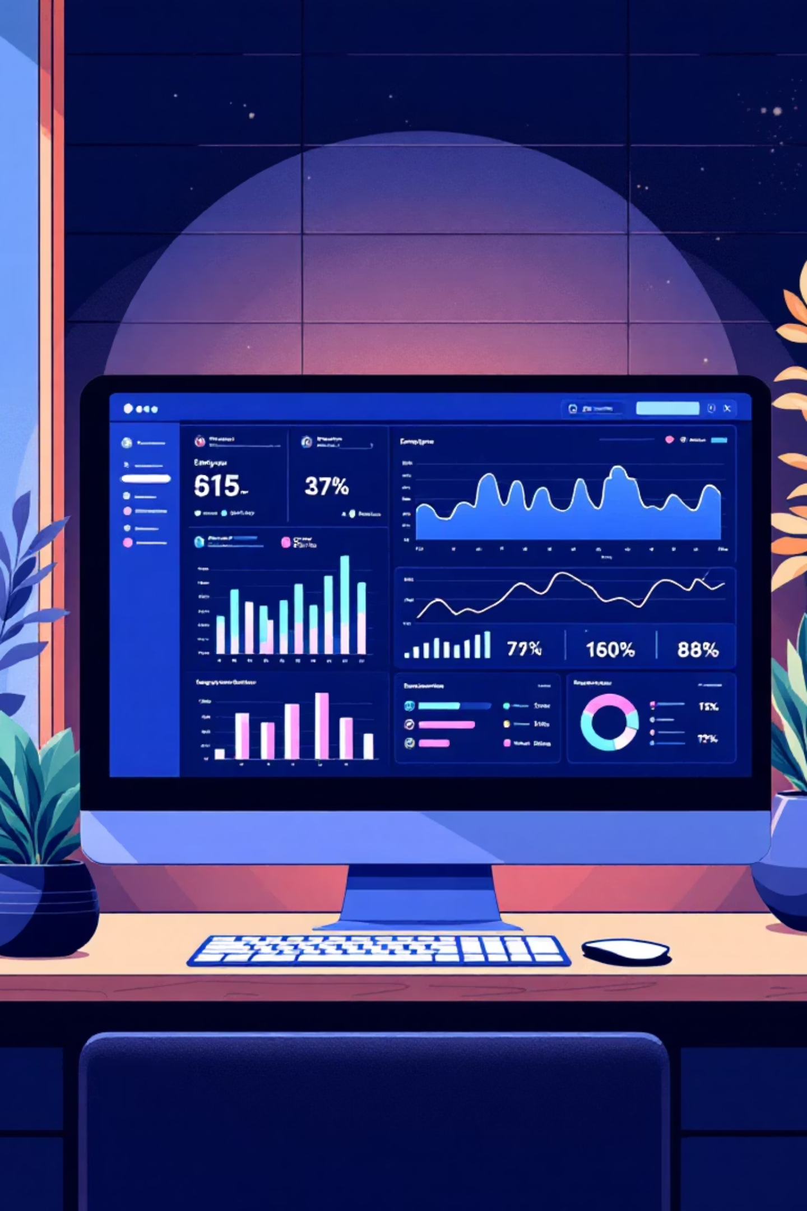
Employee Attrition & Performance Prediction
A Data-Driven HR Analytics Project

Slide 2

The Challenge HR Leaders Face
Costly Turnover
Prediction Gap
High employee attrition disrupts business operations and increases recruitment costs by up to 50% of an employee's annual salary
HR managers lack reliable tools to identify which employees are flight risks and how current staff will perform
Decision Support
Critical need for data-driven insights to make proactive retention and performance management decisions

Slide 3
Our Analytics Approach
01
02
03
Data Collection & Cleaning
Feature Engineering
Dashboard Visualization
Gathered comprehensive employee records and standardized data quality
Transformed raw data into meaningful predictive variables for machine learning
Created interactive visual tools for HR teams to explore patterns and trends
04
05
Model Training
Evaluation & Insights
Built separate prediction models for attrition risk and performance ratings
Validated model accuracy and extracted actionable business intelligence

Slide 4
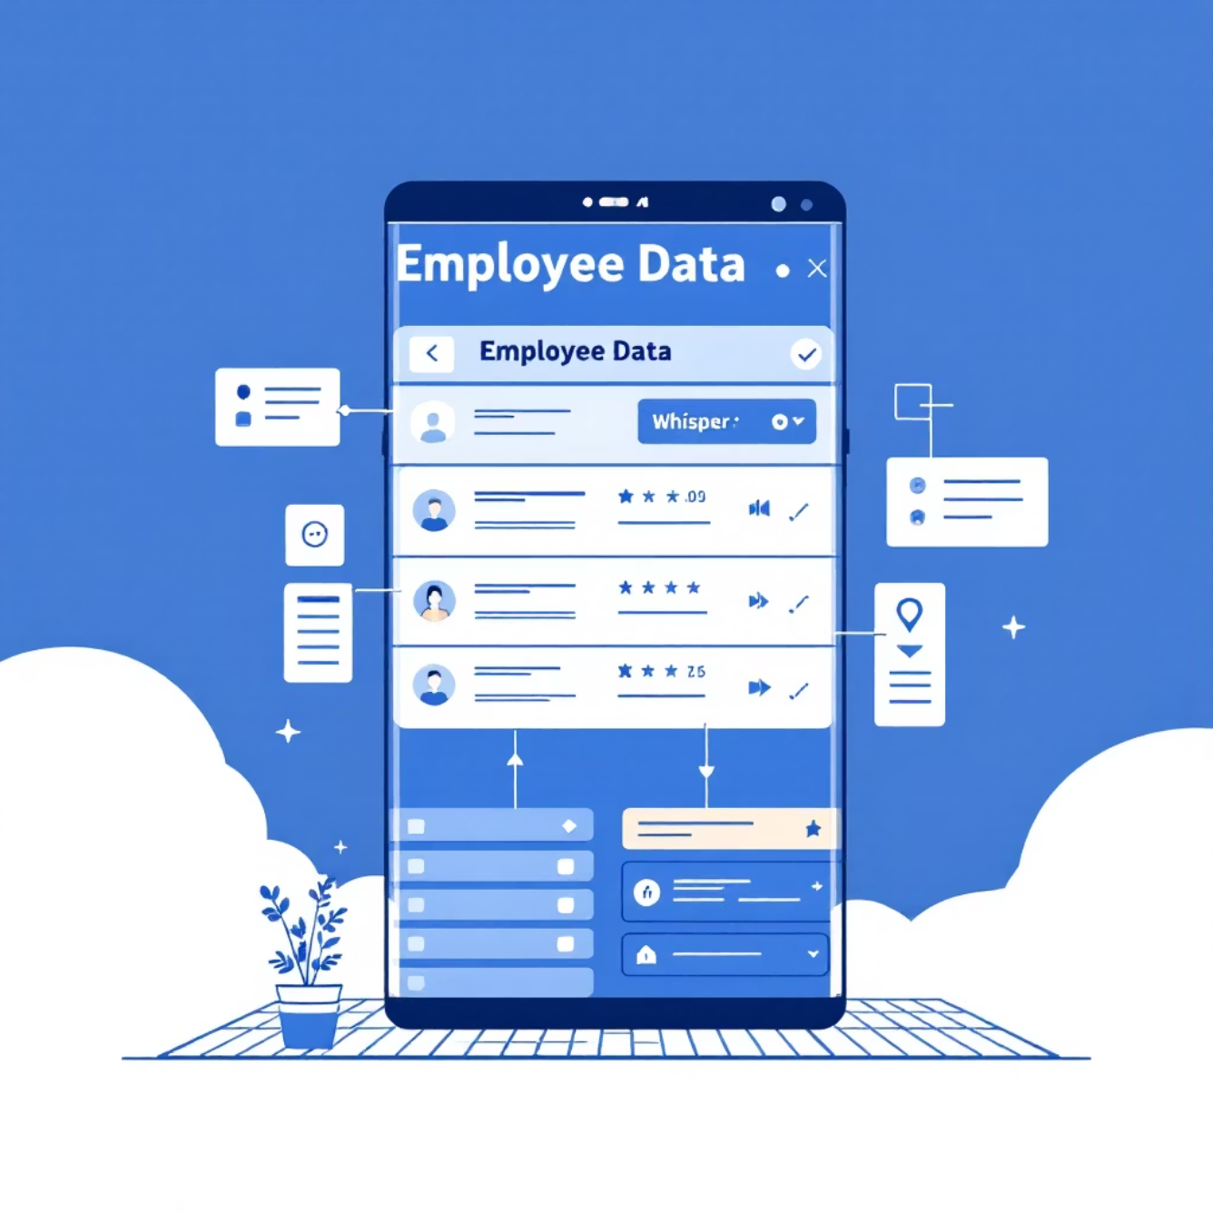
Data Foundation & Structure
Data Preprocessing Excellence
Eliminated duplicate records and standardized column naming conventions
Converted categorical values to consistent lowercase format
Established EmployeeNumber as primary index for data integrity
Strategic Dataset Architecture
Created three specialized datasets to optimize analysis and model performance:
General Dataset
Attrition Dataset
Performance Dataset
Comprehensive employee overview with demographic and role information
Focused on turnover patterns and retention factors
Dedicated to performance ratings and productivity metrics

Slide 5
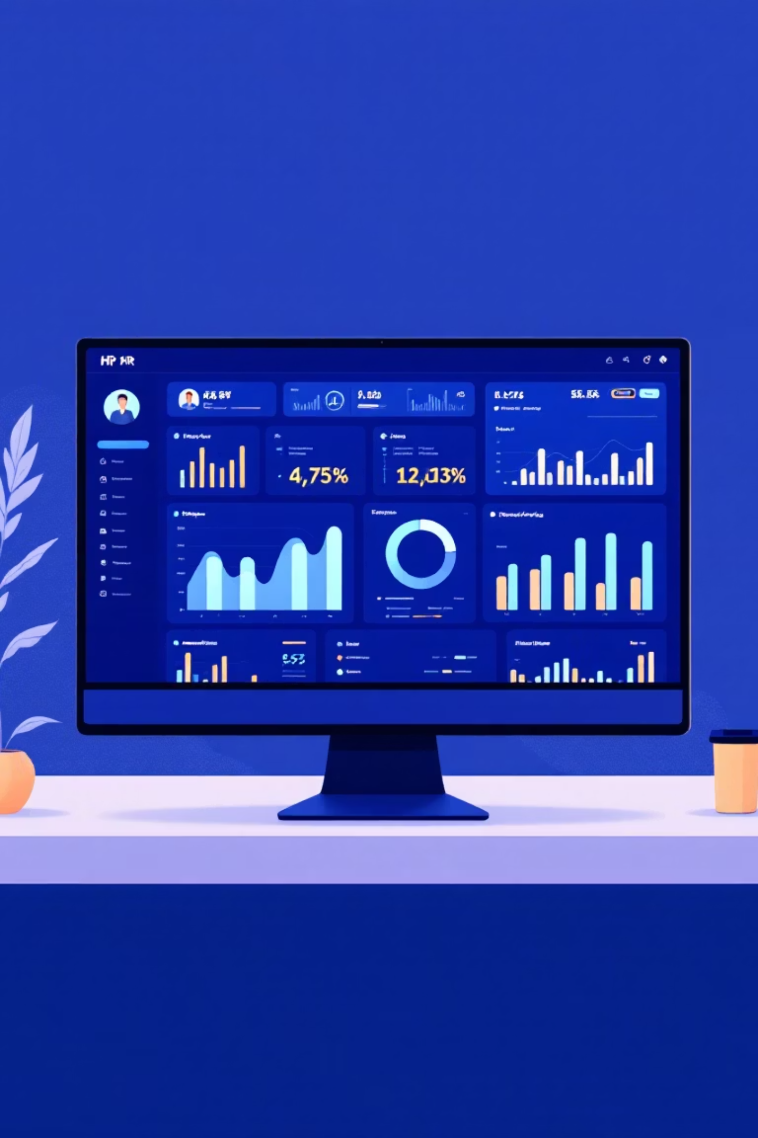
Interactive Dashboard Capabilities
Technology Stack
Key Visualizations
Built using Plotly Express and Python for dynamic, interactive visualizations that HR teams can easily navigate and interpret.
Gender distribution analysis (Pie Chart)
Attrition patterns by Department and Job Role
Education level impact on retention
Work-life balance satisfaction metrics
Environment satisfaction trends
Performance rating distribution over time

Slide 6
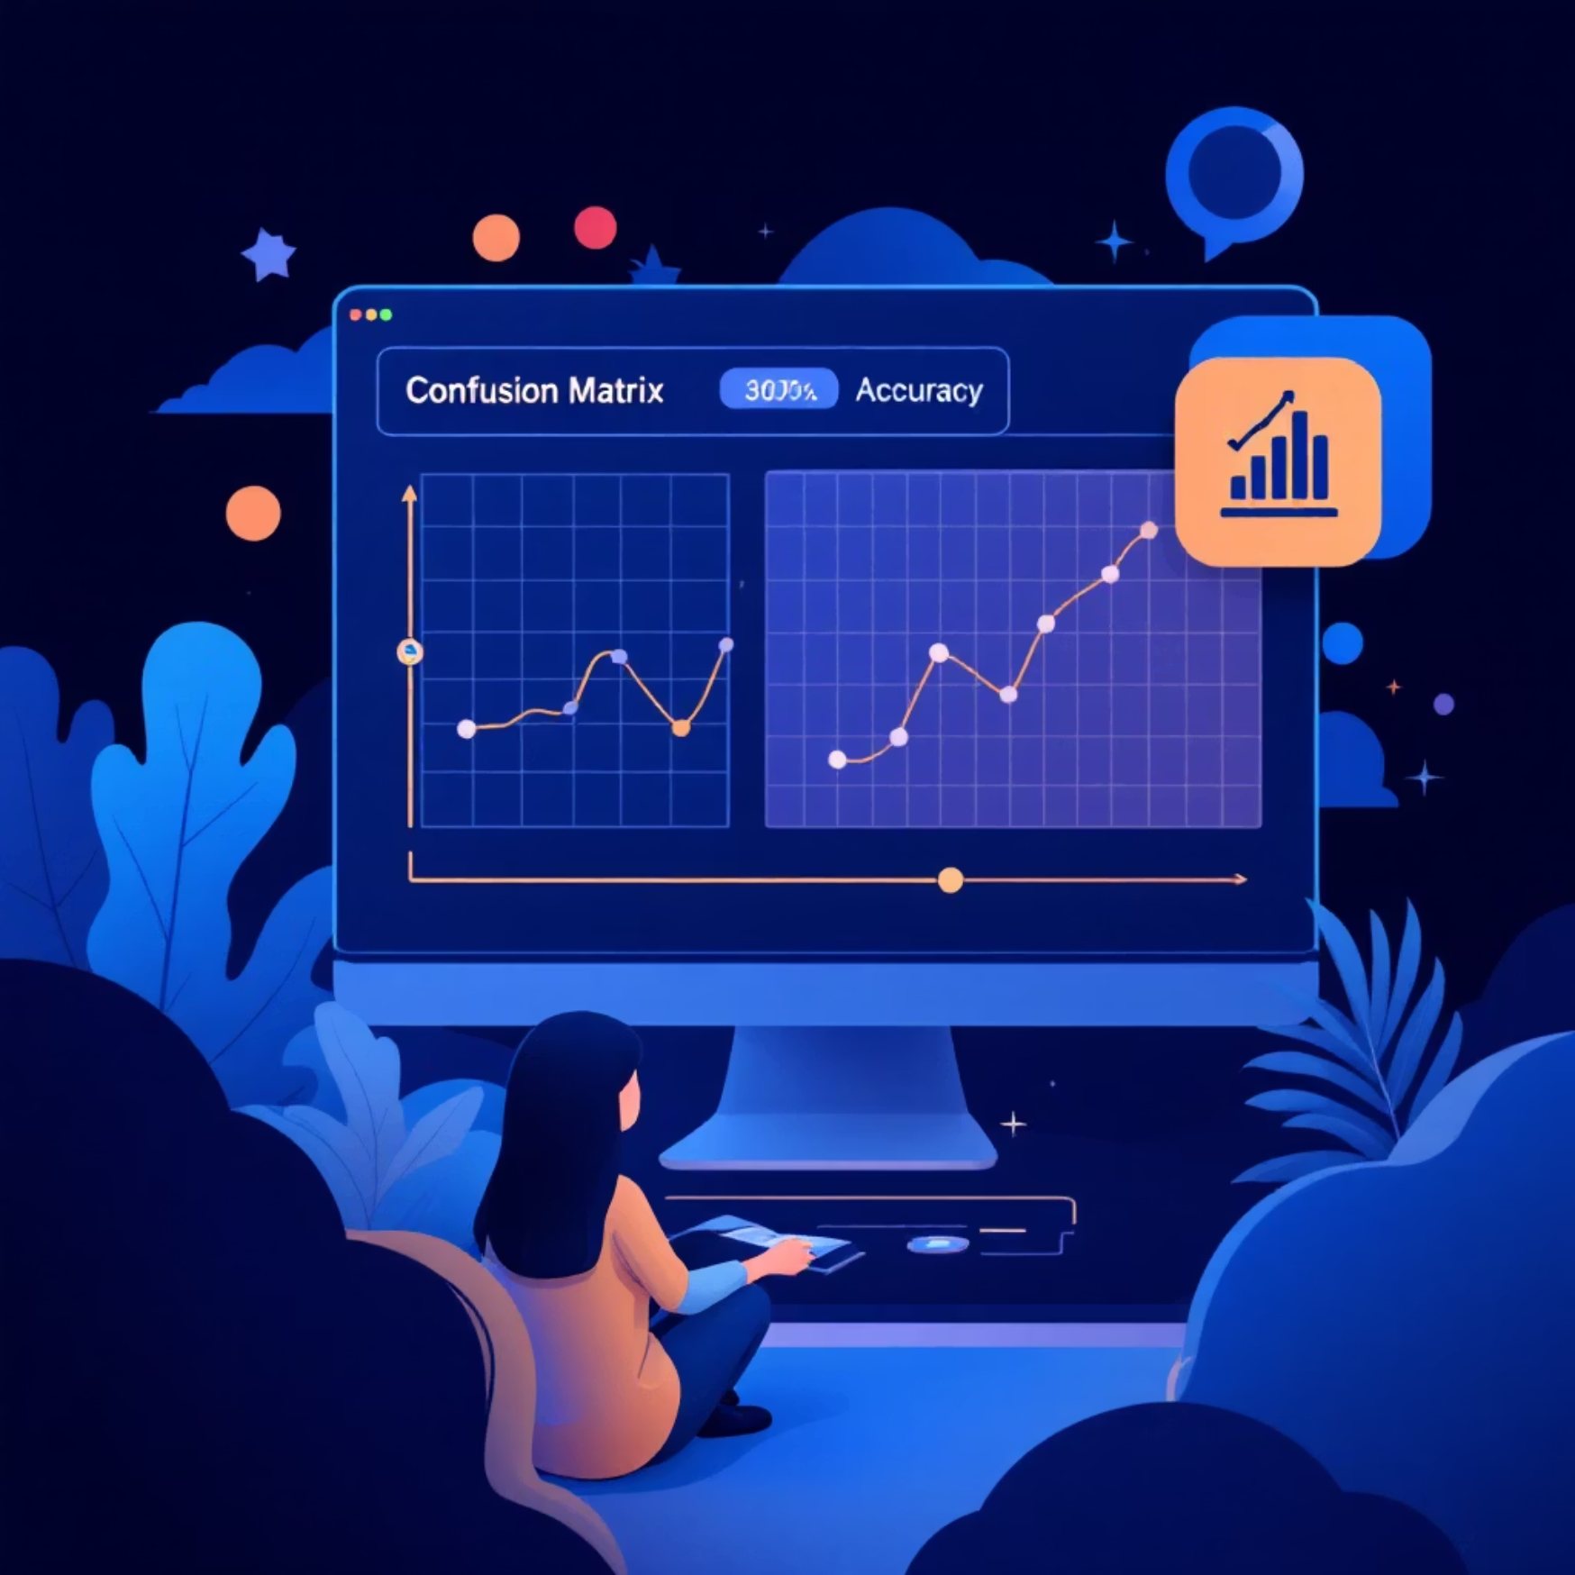

Attrition Prediction Results
89%
83%
Training Accuracy
Testing Accuracy
Strong model learning from historical data
Good generalization to new employee data
Model Performance by Class
Class 0 (Stay): Excellent prediction accuracy
Class 1 (Leave): Low recall at 31% - struggles to identify departing employees
Critical Issue Identified
Class imbalance significantly impacts model effectiveness. Most employees stay, making "leave" predictions challenging and requiring data balancing techniques.

Slide 7


Performance Prediction Excellence
100%
99%
Training Accuracy
Testing Accuracy
Perfect learning from historical performance data
Exceptional generalization to new employee performance
Model Target
Balanced Excellence
Predicts Performance Rating categories (Rating 3 vs Rating 4) with remarkable precision
Achieves optimal precision, recall, and F1-score across all performance categories, demonstrating strong generalization capabilities

Slide 8
Model Performance Comparison
Model
Train Accuracy
Test Accuracy
Key Issue
Attrition Prediction
89%
83%
Struggles with minority class (leavers)
Performance Rating Prediction
100%
99%
Excellent, well-balanced performance
The performance prediction model significantly outperforms the attrition model, providing HR leaders with a highly reliable tool for performance forecasting while the attrition model requires refinement to better identify at-risk employees.

Slide 9
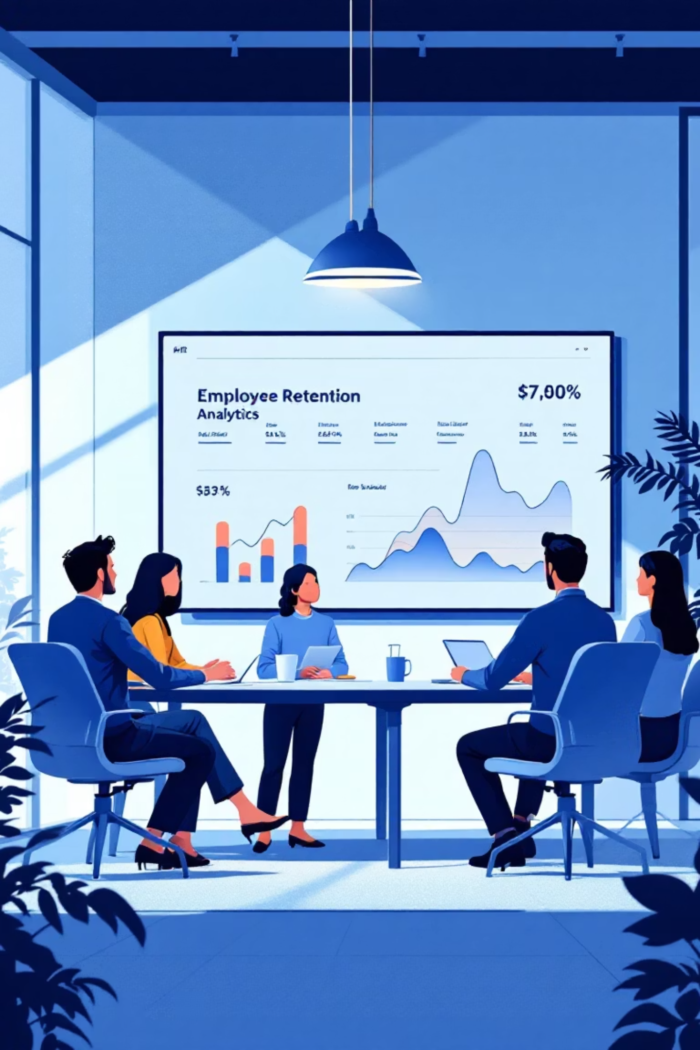




Strategic Insights & Next Steps
Attrition Model Findings
Excels at predicting employee retention but needs improvement for identifying departing employees due to class imbalance
Balancing Recommendation
Implement data balancing techniques like SMOTE or class weighting to improve minority class prediction accuracy
Performance Model Success
Highly reliable and generalizes exceptionally well - ready for immediate deployment in HR decision-making
Dashboard Impact
Provides HR teams with intuitive, actionable visualizations that transform complex data into clear business insights

